Slide 1


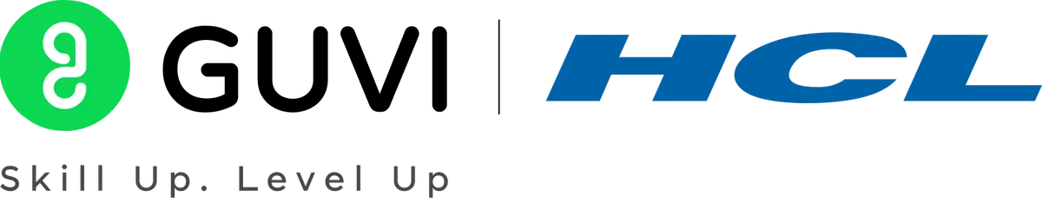

GUVI - Naan Mudhalvan
Engineering Hackathon 2025
www.guvi.in

Slide 2
Automatic Language Translation System (Multi-Lingual NLP)
Learning Programs
Presented By
Rusha R
Christina S
Iniya N
Mahadurga P
Jothi A
Mirudhula S V
Github link: https://github.com/j0xx1l/Team-Saturn-
www.guvi.in

Slide 3
Problem Statement :
India's linguistic diversity poses a major challenge in content standardization. Public services, health care portals, and educational content often exclude large non-English speaking populations. Users struggle to comprehend forms, FAQs, or medical instructions when presented in unfamiliar languages. Manual translation is time-consuming and error-prone. Machine translation tools like Google Translate often fail with regional dialects, idioms, and low-resource languages. Government schemes and startup businesses need inclusive, cost-effective translation solutions. A neural machine translation system that adapts to Indian languages and learns from domain-specific corpora is required. It should support English-Tamil , English-Hindi, and English-Malayalam as base use cases. The system must ensure fluency, contextual accuracy, and back-translation validation. Custom models for education, health, and legal content should be supported.
Learning Programs
www.guvi.in

Slide 4
Impacts:
Societal Impact :
Digital Inclusion
Boosts E-Governance & Participation
Economic Opportunities
Healthcare Impact :
Bridges Language Barriers Between Patients and Providers
Access to Medical Information in Native Languages
Learning Programs
Educational Impact :
Facilitates Teacher Training and Resource Sharing
Boosts Digital Literacy and E-Learning Participation
Business & Government Impact :
Cost Efficiency
Customer Support in Local Languages
Market Expansion
www.guvi.in

Slide 5
Technology Stack :
mBART-50 transformer model for multilingual translation
Hugging Face Transformers library
Tokenization using MBart50TokenizerFast
torch for efficient model training and inference
Open datasets for Indian language pairs
Learning Programs
www.guvi.in

Slide 6
Solution:
Developed a Transformer-based NMT for English to Hindi, Tamil, and Malayalam translation..
Trained on a large parallel corpus covering healthcare, education, and legal domains.
Uses SentencePiece tokenization and attention for context-aware, fluent translation.
Designed for low-resource languages and scalable integration in public service platforms.
Learning Programs
www.guvi.in

Slide 7
Possible to reuse:
Enables English to/from Hindi, Tamil, and Malayalam translation.
Bridges language barriers in diverse multilingual societies.
Easy to integrate into existing systems and extend to new languages or tasks.
Customizable for other domains
Facilitates access to information and services for non-English speakers.
Learning Programs
www.guvi.in

Slide 8
Points to remember:
The model is based on the Transformer architecture, known for powerful sequence-to-sequence learning.
Training uses a large, high-quality parallel corpus to improve accuracy.
Helps bridge communication gaps in multilingual societies like India.
Supports scalability and integration into public service platforms.
Learning Programs
www.guvi.in

Slide 9
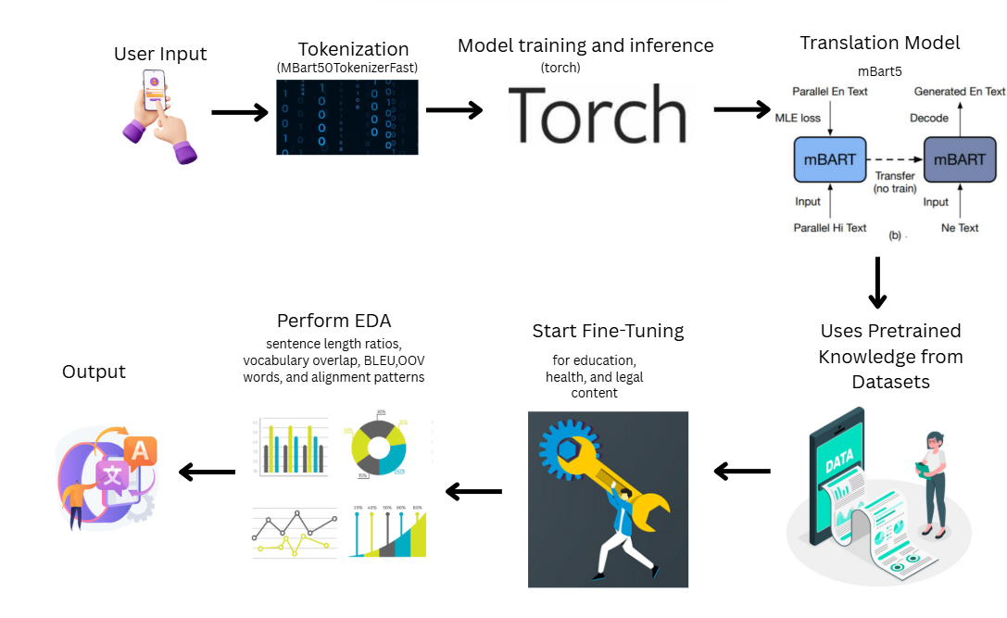
Architectural diagram:
Learning Programs
www.guvi.in

Slide 10
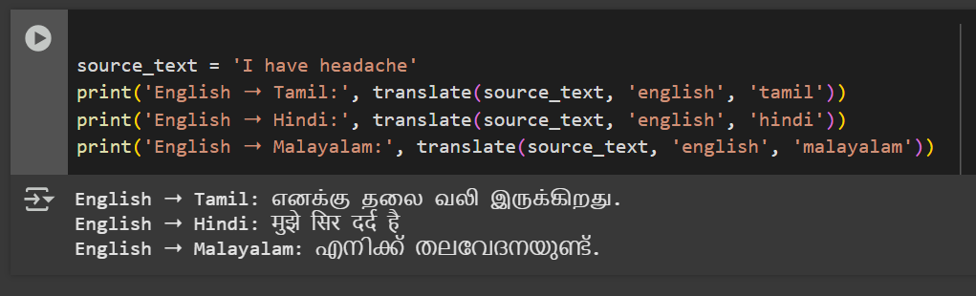
Output
www.guvi.in

